Slide 1
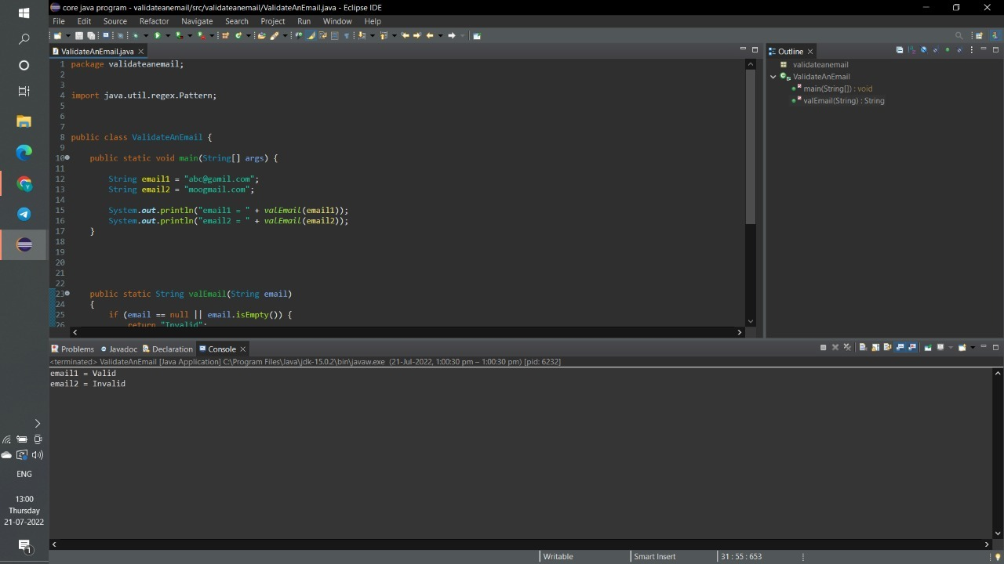
EMAIL VALIDATION SCREENSHOT

